Slide 1

Spirituality
“I can do all things through God who strengthens me.” Philippians 4:13
At East Ravendale, we strive to develop independent, self-motivated and inquisitive learners of all ages. We celebrate our uniqueness and value all as God’s children. We aim to give all members of our community opportunities to succeed, now and in the future, knowing they are safe and valued.
Our vision is underpinned by our core values of wonder, belief and joy.

Slide 2
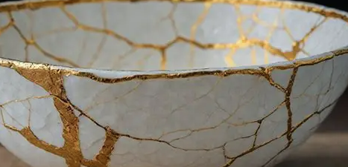

What is spirituality?
Spirituality is the feeling, sense or belief that there is something greater than ourselves. Theis could be a religious figure such as God or Jesus for Christians or Allah for Muslims, For some people, it may even be a connection with nature
We think of Spirituality as ‘Golden Glue’. It mends the cracks in our lives, transforming our experiences into something beautiful and meaningful, much like the Japanese art of Kintsugi.

Slide 3
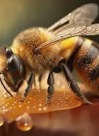
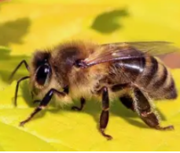
Spirituality and the bees
Bees are tiny yet achieve incredible things. They pollinate, make amazing hives and honey.. They are a natural wonder.
Like the verse teaches, great strength and impact don’t come from our size or ability, but from the One who empowers us.
Bees remind us that God can use anyone, no matter how small, to accomplish big things.

Slide 4
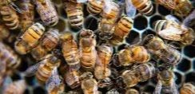
Spirituality and the bees
Bees Bring Life Wherever They Go
Bees don’t just gather nectar — they spread life through pollination.
With Christ strengthening us, we bring life, encouragement, and growth into the world.

Slide 5
Spirituality and the bees
Bees Work Together in Harmony
They depend on each other for strength and survival.
Just as bees rely on the hive, we rely on Christ. Our strength isn’t solitary — it’s supported, sustained, and provided by God.

Slide 6
Spirituality and the bees
Honey as a Symbol of God’s Goodness
Honey in the Bible symbolises:
Blessings and Goodness
Christ strengthens us not just to endure but to produce something sweet — like kindness, wonder and joy.

Slide 7
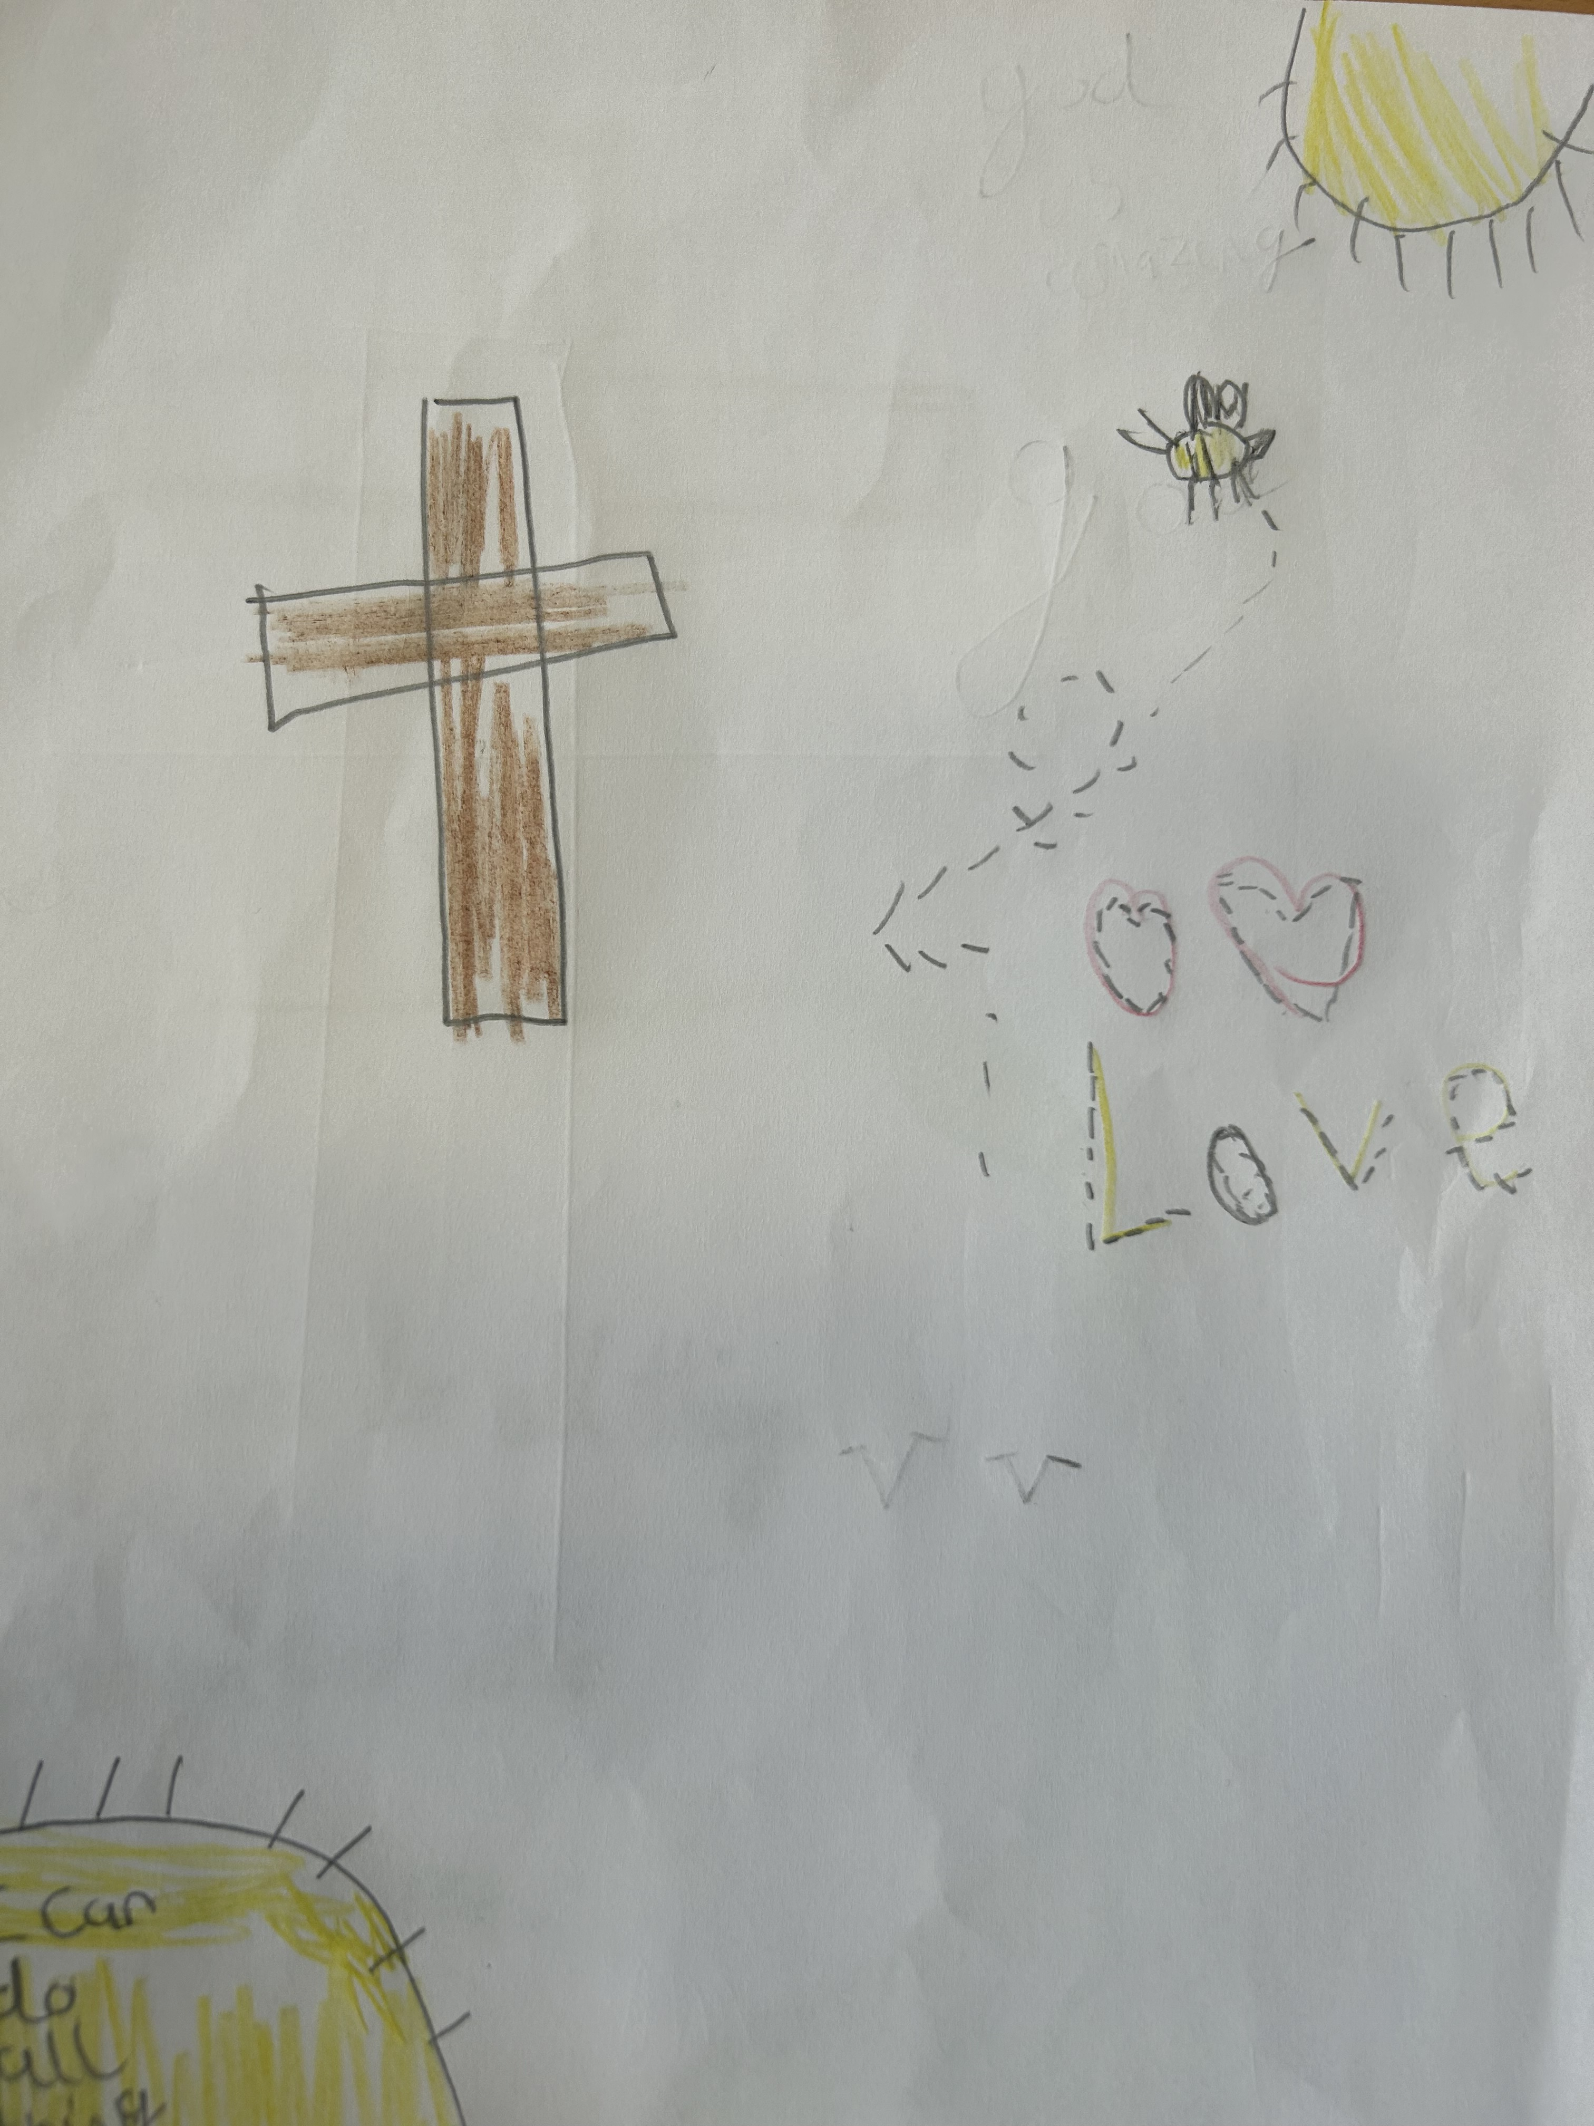
Ow times - Belief
Sometimes in school there are ‘Ow’ times, and we need to find strength and belief.
We remember times, we didn’t do well at Bikeability, found a lesson hard or fallen out with friends – but we find strength in friends, teachers and belief.
Just like bees – we can keep going even when things are tough.

Slide 8
The Wow times – Wonder
Our days are filled with ‘Wow’ moments and Wonder, reminding us that through God’s strength even the smallest things can be special.
Here are a few –
Blue RAG in your work
Headteacher award
Collecting the Christmas Tree
Bees
Seeing everyone’s achievements in Celebration worship.
Science and History lessons.

Slide 9
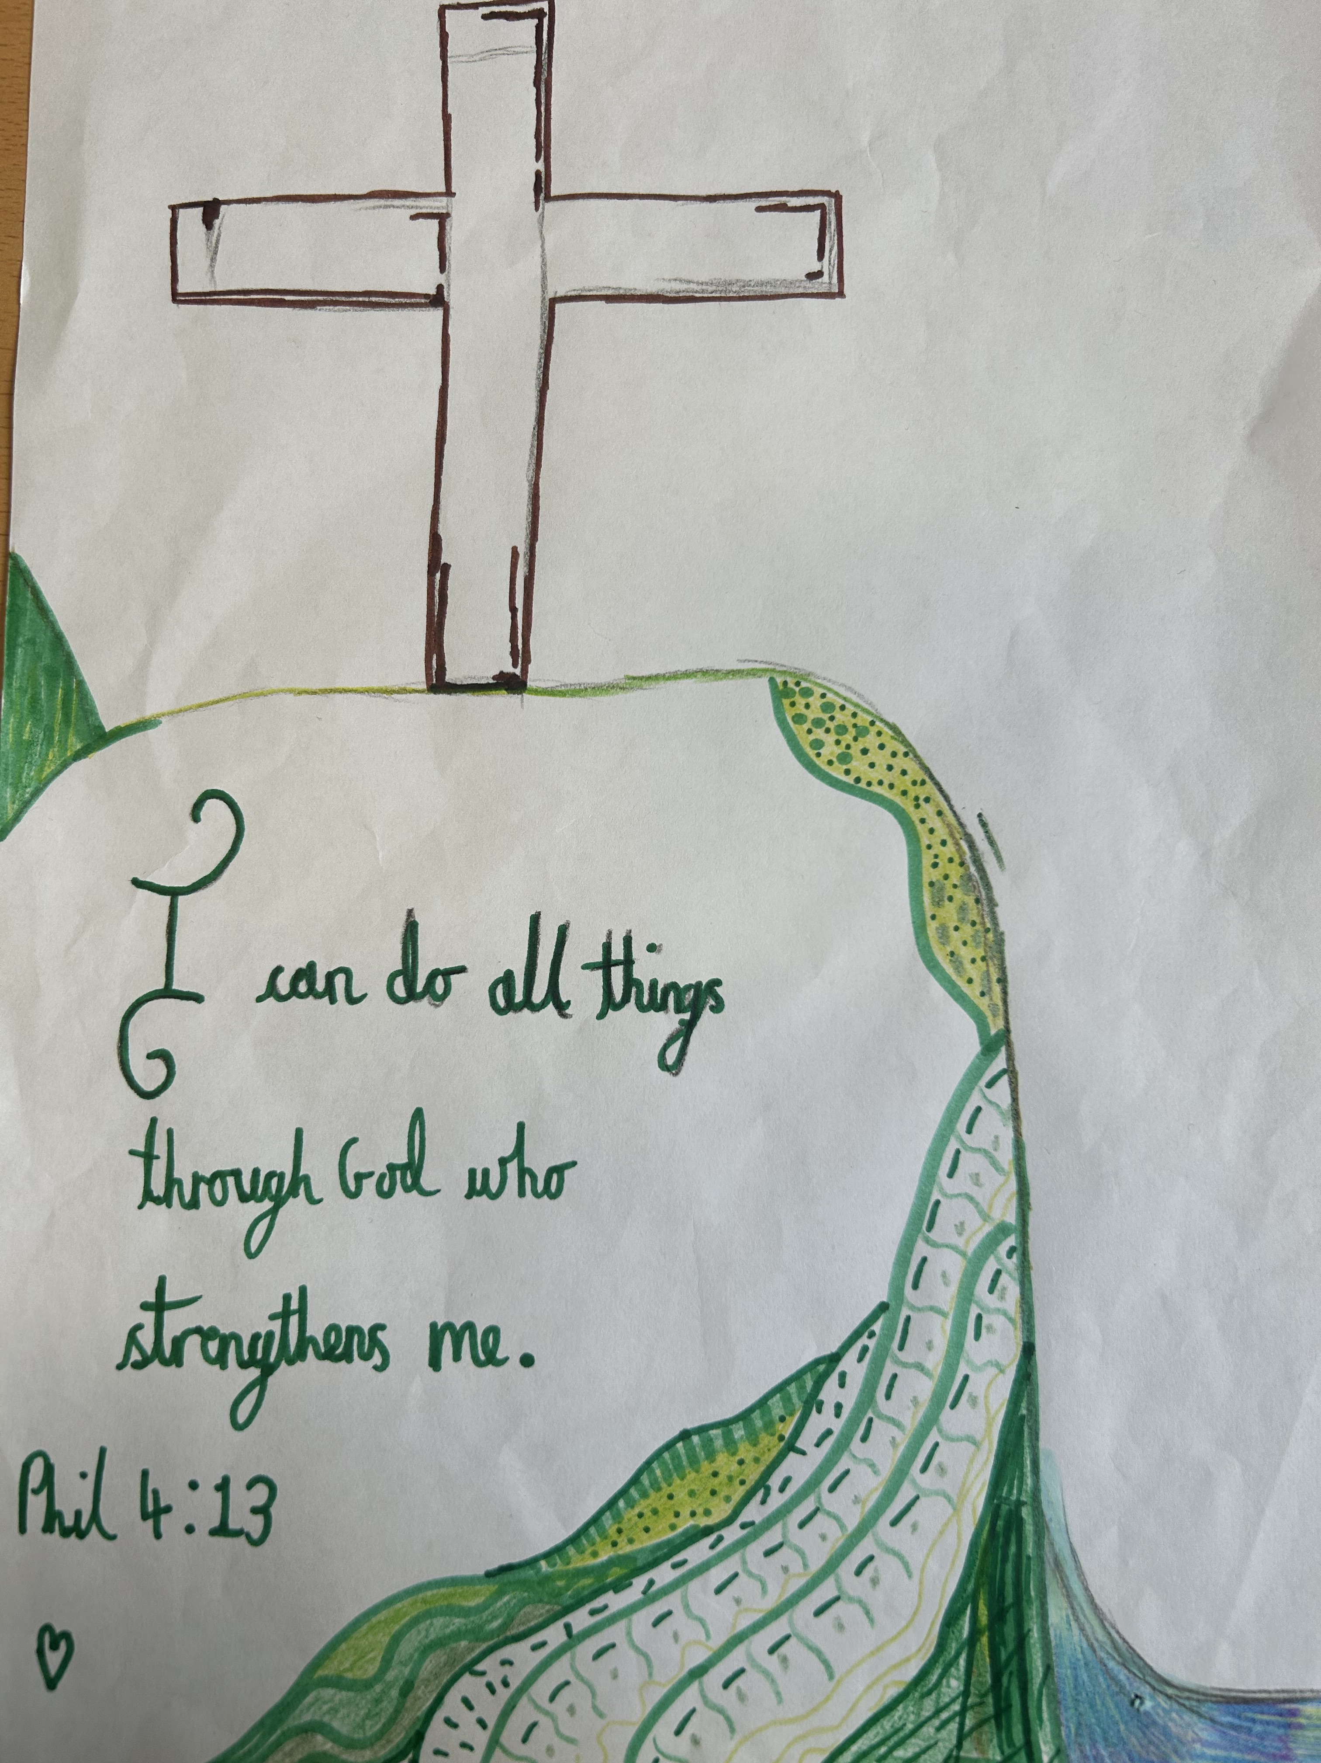
The ‘Now’ times – Joy
In the ‘now’ times, the joyful times, we thank God for the amazing, wonderful time we are having or going to have. It is through this moment that we connect with God.

Slide 10
Time to reflect, time to pray.
Dear Lord,
Thank you for our teachers, our family and our friends who help us follow the right path in the footsteps of Jesus.
May we lean on them and rejoice with them through the ow times. The wow times and the now times. Through Wonder, Belief and Joy.
Amen

